Slide 1
Deep learning algorithms

Slide 2
Quick reminder
If you feel uncomfortable with python, data analysis and data visualization
PLEASE give a try to our course: Introduction to python for Data Science

Slide 3
Data analysis with python
The course will be hosted by Emre in C302
The content of the course will be:
6/02/2020: Basics of Python
13/02/2020: Pandas and Matplotlib
20/02/2020: Linear and Polynomial regression
21/02/2020: Final Workshop

Slide 4

Election time

Slide 5

The committee

Slide 6
About me
2nd Year computer science student at City University of London
I am really interested on Machine Learning and Water Polo

Slide 7

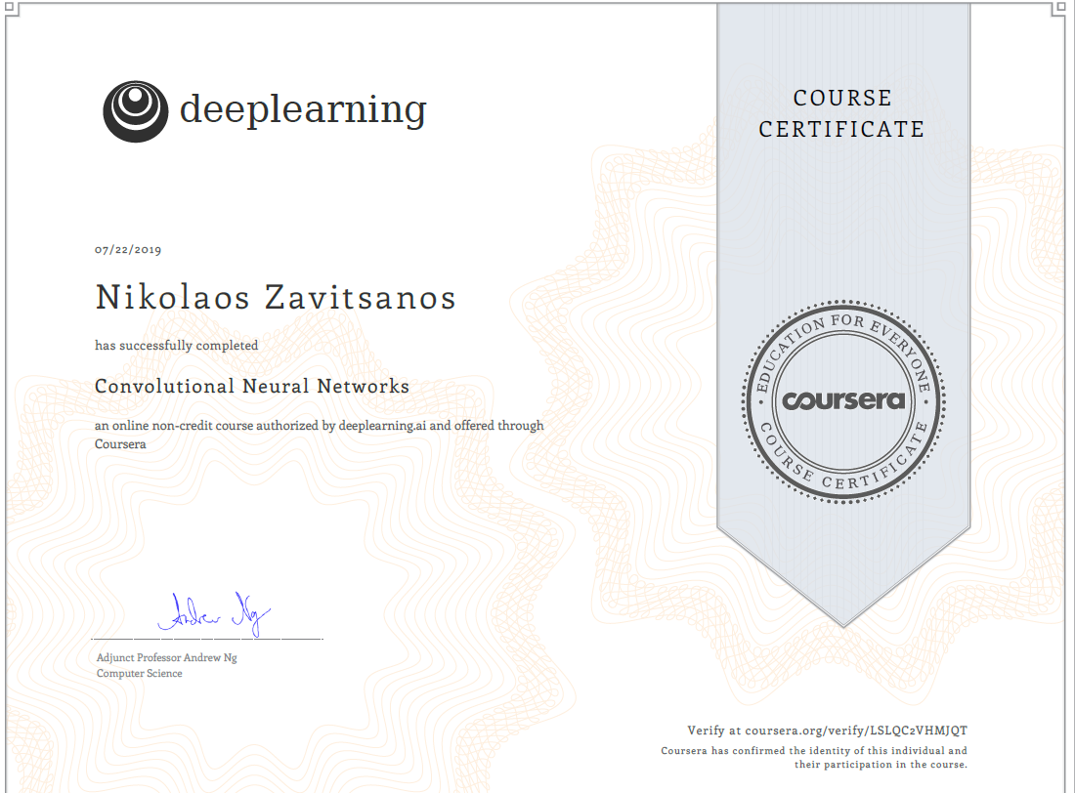
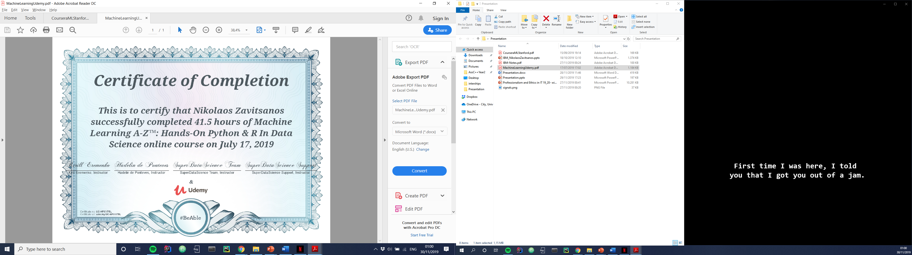
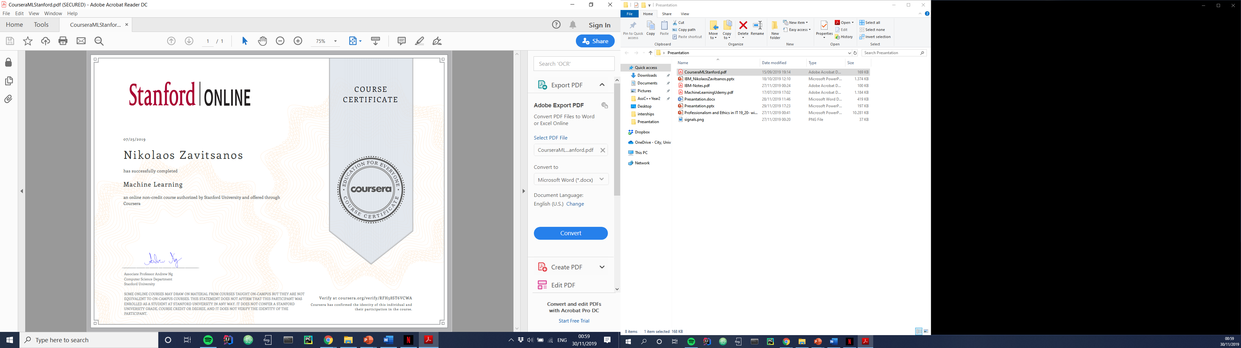
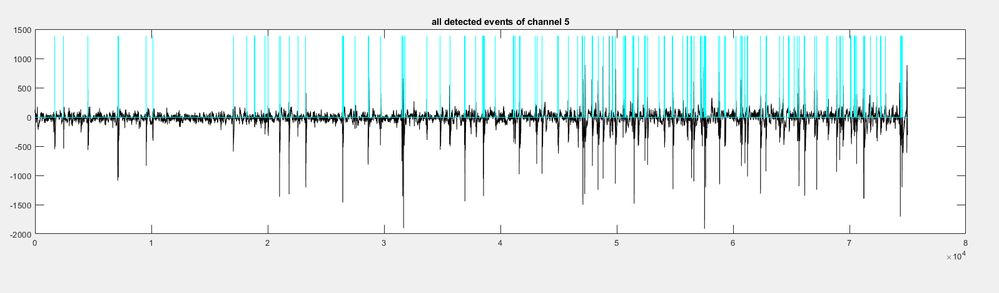
What I have done with machine learning

Slide 8
Let’s start
This will be 3-week course on: 4th, 11th, 18th of February in C307.
We will cover
Basic theory of deep learning
Artificial Neural Networks
A Workshop is following the course.
But first what is deep learning ?
Notes:
Workshop convo - ann nets
K – means and unsupervised learning

Slide 9
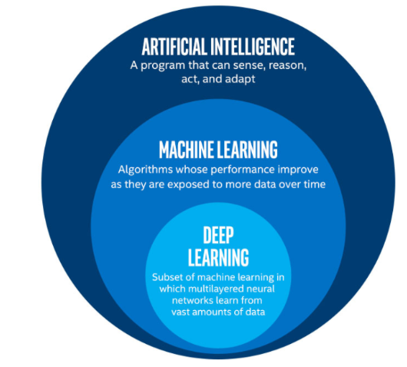
Notes:
AI: any machins behavior that if a human did the same task we would say that they used intelligence
ML: algorithms whose performance improve as they exposed to more data glustering- classification- regression
Deep learning: complex ml algorithms

Slide 10
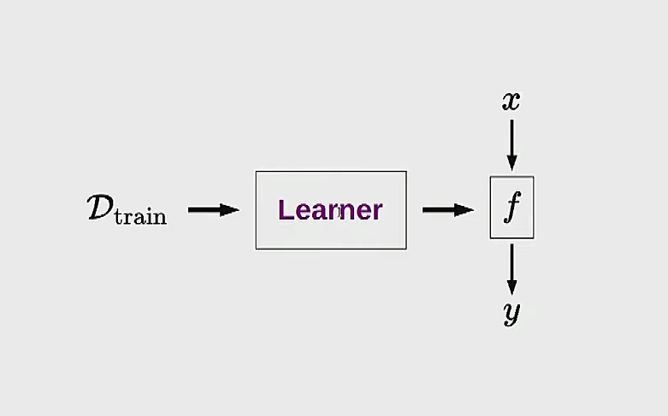

Slide 11
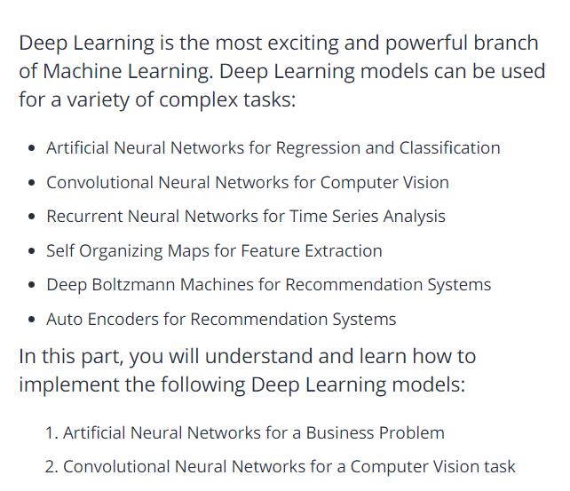

Slide 12
CONTENT
WEEK 1: INTRODUCTION IN MACHINE LEARNING
WEEK 2: ARTFICIAL NEURAL NETWORKS(Theory)
WEEK 3: ARTFICIAL NEURAL NETWORKS(Practical)
Notes:
This lecture probably will be boring the next two we will be really fun I hope so at least

Slide 13
Today’s Plan
SUPERVISED VS UNSUPERVISED
DIVIDE OUR DATA
COST FUNCTION
GRADIENT DESCENT
UNDERFITTING VS OVERFITTING
SET UP THE ENVIROMENT

Slide 14
Supervised vs unsupervised learning

Slide 15
Supervised learning
Notes:
Ask what is supervised learning from the Ben’s course

Slide 16
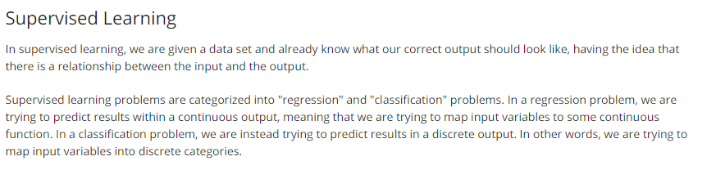
Notes:
Explain draw a linear regression

Slide 17
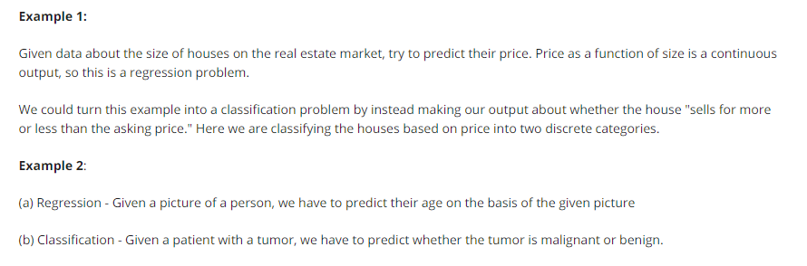

Slide 18
Unsupervised learning
Notes:
Ask what is unsupervised learning

Slide 19
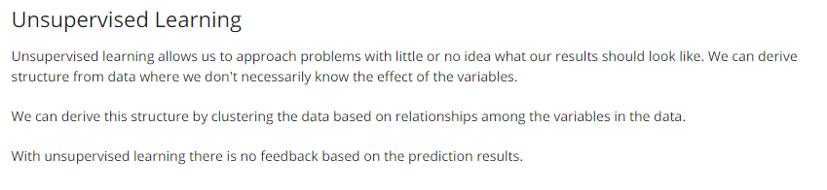

Slide 20
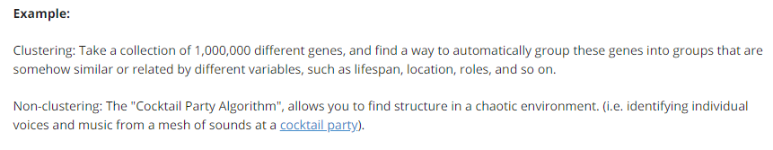
Notes:
Create the glaph with a lot of color

Slide 21
Divide our data
Training set (approx. 70%)
Cross Validation (approx. 10%)
Test set (approx. 20%)
Notes:
Briefly why we use cross validation set

Slide 22
Cost function

Slide 23
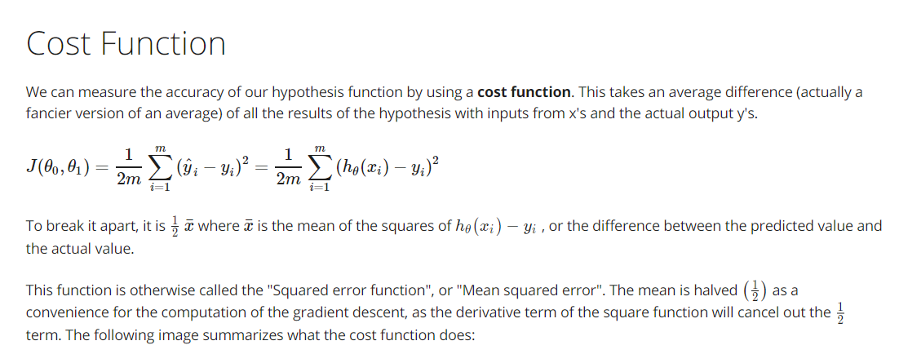

Slide 24
Gradient descent
Notes:
Draw the x ^ 2 and explain it before you go to the next slide

Slide 25
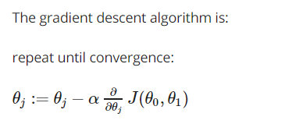
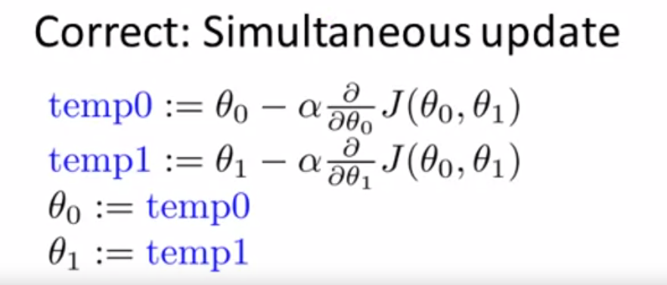
Notes:
Explain briefly the type
Explain why this is the correct implematation

Slide 26
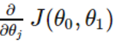
a = learning rate(How big the step is)
Derivative
Notes:
Explain why the learning rate is important

Slide 27
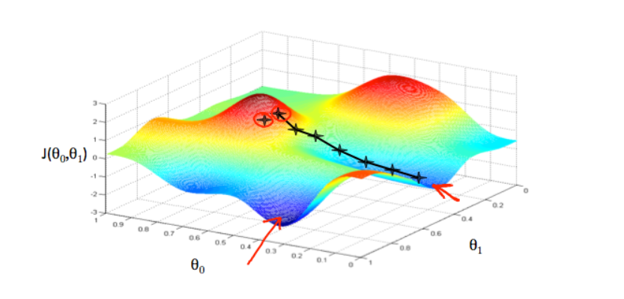
Notes:
Can everyone read a 3d graph ???

Slide 28
Types of gradient descent
Batch Gradient Descent.
Stochastic Gradient Descent.
Mini-Batch Gradient Descent
Notes:
Next week we are going to see an example for the difference between stochastic and batch gradient descent
Eplain briefly the differences

Slide 29
Underfitting Vs overfitting
Notes:
Explain what is underfitting (has poor performance)
Explain what Is overfitting (our algorithms is not generalized well) really important and tricky

Slide 30
underfitting

Slide 31
Overfitting
Notes:
What they think that overfitting is?
Ways to stop overfitting?
High variance?
Connection high variance with cost function

Slide 32
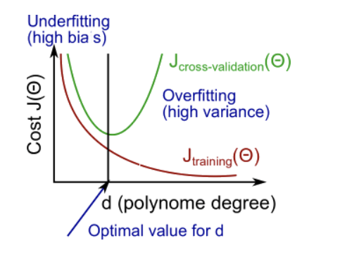

Slide 33
Ways to deal with underfitting (high bias)

Slide 34
More data
More features
Better algorithm

Slide 35
Ways to deal with Overfitting (High Variance)

Slide 36
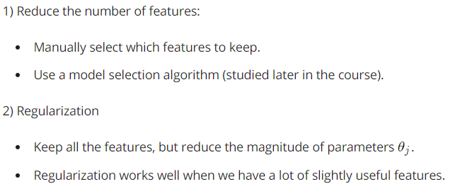

Slide 37
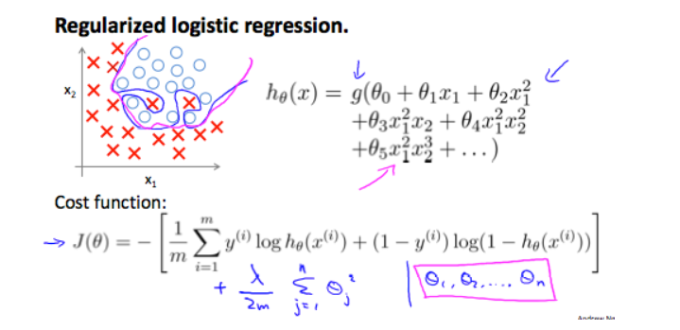
Notes:
If we have a lot of different features we would have the blue line but because we are using regulazation adding a constant number we prevent this and we achieve the red line

Slide 38
Let’s set up the software
ANACONDA https://www.anaconda.com/
ATOM https://atom.io/

Slide 39
Install Frameworks
Installing TensorFlow:
https://docs.anaconda.com/anaconda/user-guide/tasks/tensorflow/
Installing Keras:
conda install -c conda-forge keras

Slide 40
Suggested videos and books
HEROES OF DEEP LEARNING: https://www.youtube.com/watch?v=-eyhCTvrEtE
HANDS ON MACHINE LEARNING WITH SCIKIT-LEARN, KERAS AND TENSORFLOW https://tinyurl.com/v9rha97
Interview of Elon Musk:https://www.youtube.com/watch?v=dEv99vxKjVI&t=501s

